Slide 1
AIRLINE PASSENGER SATISFACTION
By
S.R. Arun Kartheik

Slide 2
AGENDA
Problem Statement
Project Flow
Data Collection
Preprocessing
First DataFrame
Class Imbalance
Outliers
Second DataFrame
Feature Selection
Third DataFrame

Slide 3
PROBLEM STATEMENT
The dataset is based on the information of the airline passengers given in the model.
To develop a machine learning model that can predict satisfaction(target variable) whether the customer is satisfied (or) not satisfied.
The classification goal is to predict which percentage of airline passengers are satisfied.

Slide 4
Data Collection
Data
Preprocessing
Data Frame 1
FLOW CHART
Class Imbalance
EDA
Data Frame 2
Feature Selection
Data Frame 3

Slide 5
DATA COLLECTION:
The dataset contains 1,29,980 rows and 24 columns.
It has 19 numerical columns and 5 categorical columns.
Target Column(satisfaction) is categorical, so classification Machine Learning Algorithm is performed.

Slide 6
PREPROCESSING
Missing value treatment.
Data Type Conversion .
Duplicate Checking.

Slide 7
DATA FRAME 1
 | Model Name | Accuracy | fpr | tpr | F1 score
0 | log | 78.295350 | 0.207768 | 0.775835 | 0.801800
1 | dt | 94.795196 | 0.054713 | 0.948568 | 0.953074
2 | rf | 96.311980 | 0.055334 | 0.978094 | 0.785640
3 | knn | 74.437943 | 0.364370 | 0.827811 | 0.785640
4 | naive | 60.894672 | 0.407555 | 0.621607 | 0.642727
5 | svc | 67.485371 | 0.542343 | 0.841486 | 0.745480
6 | adaboost | 94.772097 | 0.055777 | 0.950473 | 0.953684
7 | xgboost | 96.400524 | 0.051166 | 0.975645 | 0.968430
Data Frame
XGBOOST is the best fitted model.

Slide 8
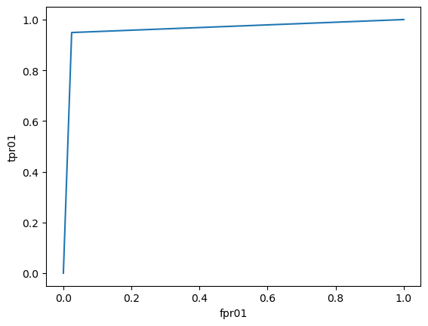
Conclusion for Data Frame 1:
In data frame 1, XGBOOST has the highest accuracy of (96.40) with a false positive rate(fpr) of (0.051) and the true positive rate (tpr) of (0.9756)
Result of AUC-ROC Curve

Slide 9
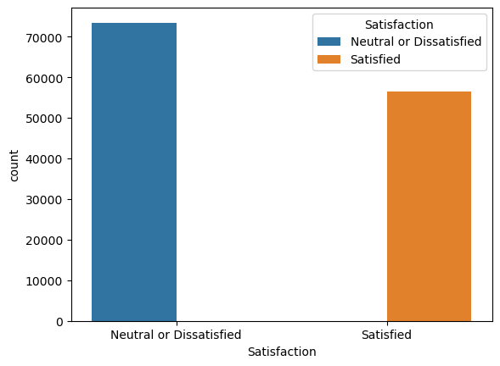
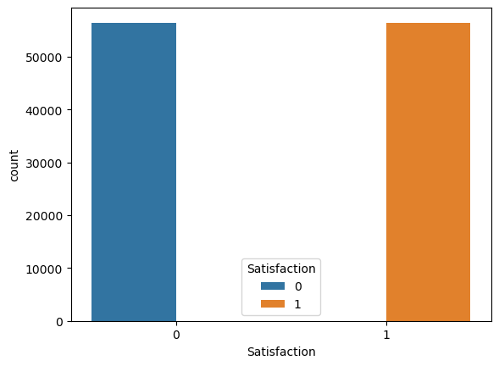
CLASS IMBALANCE
Performed Undersampling technique these are before and after the class imbalance of target variable.
Before
After

Slide 10
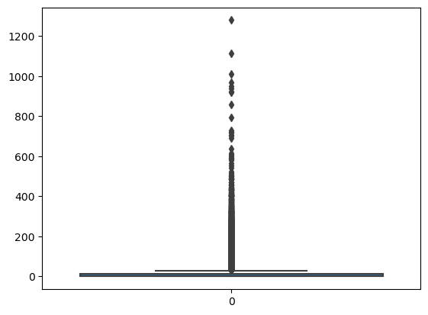
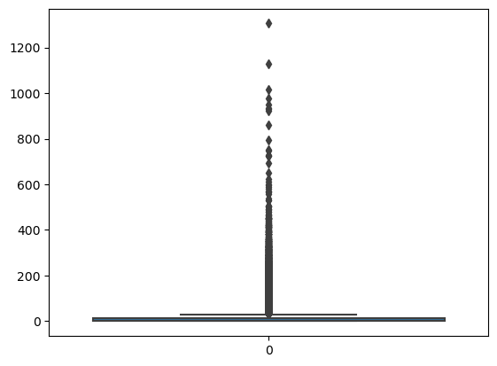
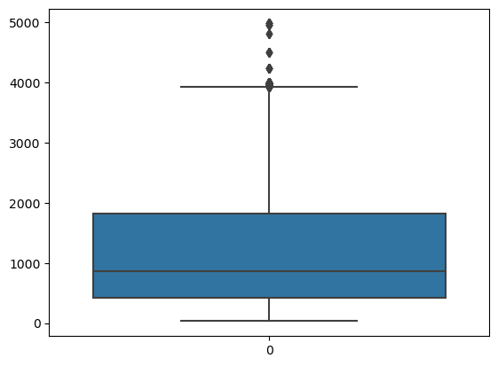

Outliers:
Box Plot for outlier in data.
Flight-Distance
Arrival Delay
Departure Delay

Slide 11
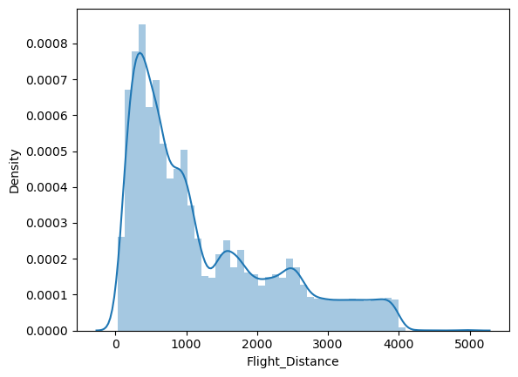
Skewness:
Flight-Distance
Before
After

Slide 12
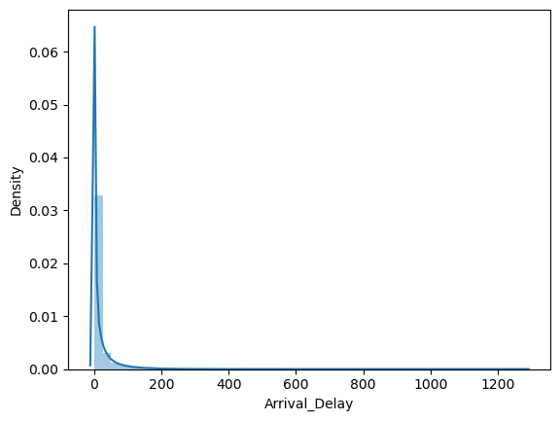
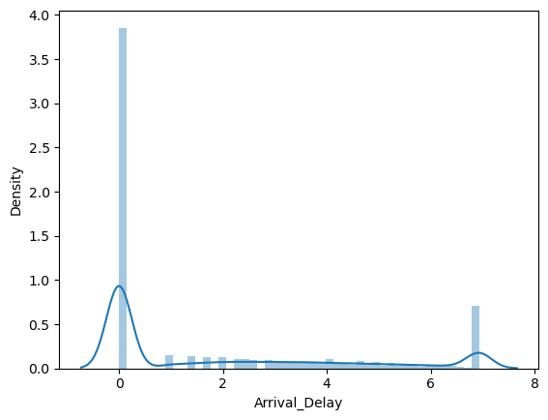
Arrival Delay
Before
After

Slide 13
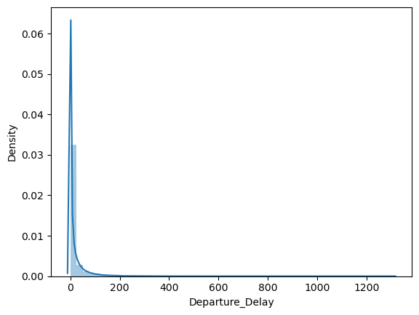
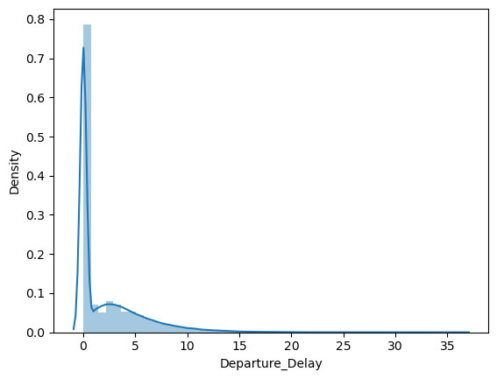
Departure-Delay
Before
After

Slide 14
DATA FRAME 2
 | Model Name | Accuracy | fpr | tpr | F1 score
0 | log | 80.528974 | 0.144423 | 0.744448 | 0.787947
1 | dt | 94.063441 | 0.055418 | 0.938977 | 0.941486
2 | rf | 95.853270 | 0.051264 | 0.967134 | 0.958198
3 | knn | 72.678540 | 0.297419 | 0.742228 | 0.727273
4 | naive | 60.468722 | 0.408874 | 0.623201 | 0.612751
5 | svc | 64.792663 | 0.507690 | 0.797122 | 0.690945
6 | adaboost | 93.970406 | 0.054092 | 0.938533 | 0.941879
7 | xgboost | 96.008329 | 0.047817 | 0.969710 | 0.961173
XGBOOST is the best fitted model

Slide 15
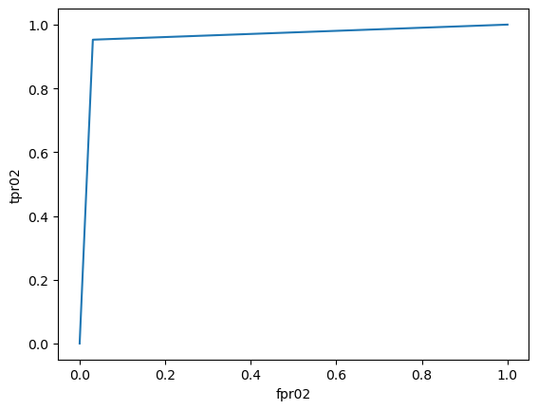
Conclusion for Data Frame 2
In data frame 2, XGBOOST has the highest accuracy of (96.002) with a false positive rate(fpr) of (0.047) and the true positive rate (tpr) of (0.9611).
Result of AUC-ROC Curve

Slide 16
Feature Engineering:
Performed recursive feature elimination (rfe).
Dataset having 22 columns where 11 columns are selected as important feature and considered significant.

Slide 17
DATA FRAME 3
 | Model Name | Accuracy | fpr | tpr | F1 score
0 | log | 84.937090 | 0.142744 | 0.855747 | 0.856089
1 | dt | 93.407762 | 0.061605 | 0.931604 | 0.934634
2 | rf | 95.210881 | 0.059042 | 0.964914 | 0.953355
3 | knn | 86.859826 | 0.157858 | 0.897229 | 0.872845
4 | naive | 73.174730 | 0.264805 | 0.732013 | 0.732696
5 | svc | 87.285132 | 0.149372 | 0.895985 | 0.875798
6 | adaboost | 93.474216 | 0.062577 | 0.932226 | 0.934509
7 | xgboost | 95.436824 | 0.055153 | 0.964203 | 0.954831
XGBOOST is the best fitted model

Slide 18
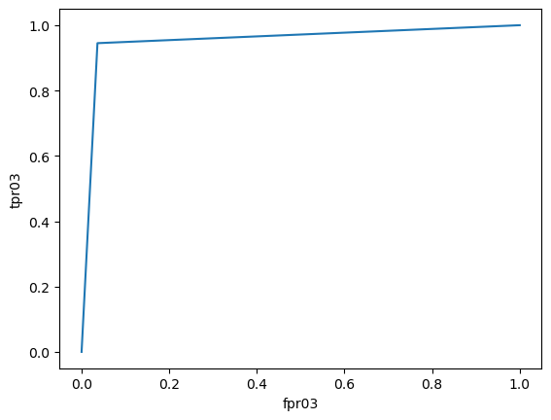
Conclusion for Data Frame 3
In data frame 3, XGBOOST has the highest accuracy of (95.30) with a false positive rate(fpr) of (0.055) and the true positive rate (tpr) of (0.9642).
Result of AUC-ROC Curve

Slide 19
Merits:
Insight into Customer Preferences:
The dataset can offer valuable insights into what factors contribute to passenger satisfaction, such as flight punctuality, seat comfort, in-flight services, etc. This information is crucial for airlines to tailor their services to meet customer expectations better.
Benchmarking and Comparison:
Airlines can use the dataset to benchmark their performance against competitors and industry standards. Understanding how they fare in terms of passenger satisfaction compared to others can help them identify areas for improvement.
Predictive Analytics:
By analyzing historical data on passenger satisfaction, airlines can build predictive models to forecast future trends and anticipate potential issues. This can help in proactive decision-making and resource allocation.

Slide 20
Customer Segmentation:
The dataset can facilitate segmentation analysis, allowing airlines to identify different customer segments with varying satisfaction levels. This information can be used to personalize marketing strategies and services for different groups of passengers.
Quality Improvement:
Feedback from passenger satisfaction surveys can highlight areas where airlines excel and areas where they need to improve. This can guide initiatives aimed at enhancing service quality and overall customer experience.

Slide 21
Demerits
Biased Sampling:
The dataset may suffer from biased sampling, as it typically includes responses from passengers who voluntarily participate in surveys. This could lead to an overrepresentation of extreme opinions or certain demographic groups, affecting the generalizability of findings.
Subjective Nature:
Passenger satisfaction is inherently subjective and can vary greatly depending on individual preferences and expectations. As a result, the dataset may contain subjective responses that are difficult to quantify or interpret accurately.
Limited Scope:
The dataset may not capture the full spectrum of factors influencing passenger satisfaction. For example, it may focus primarily on in-flight experiences and overlook other important factors such as booking process, check-in procedures, or baggage handling.

Slide 22
Data Quality Issues:
Like any dataset, there may be issues related to data quality, such as missing values, inconsistencies, or errors. Cleaning and preprocessing the data to address these issues can be time-consuming and may require additional resources.
Lack of Context:
Without additional contextual information, such as the specific circumstances surrounding each flight or passenger interaction, it may be challenging to interpret the data accurately. Contextual factors can significantly influence passenger satisfaction but may not be adequately captured in the dataset.
Temporal Dynamics:
Passenger preferences and satisfaction levels may change over time due to various factors such as market trends, economic conditions, or changes in airline policies. Therefore, the dataset's relevance and validity may diminish over time without regular updates and refreshes.

Slide 23
THANK YOU

